Slide 1
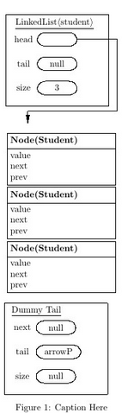
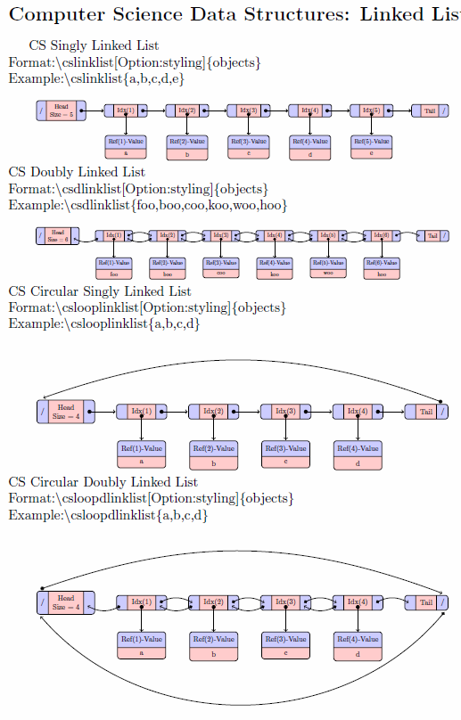
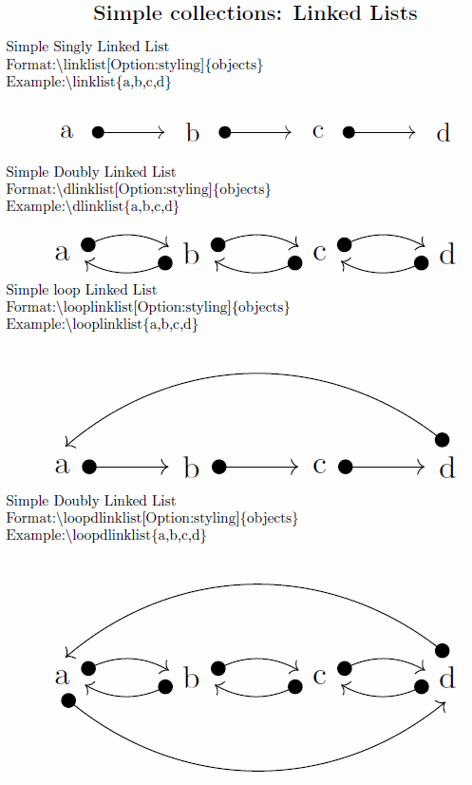
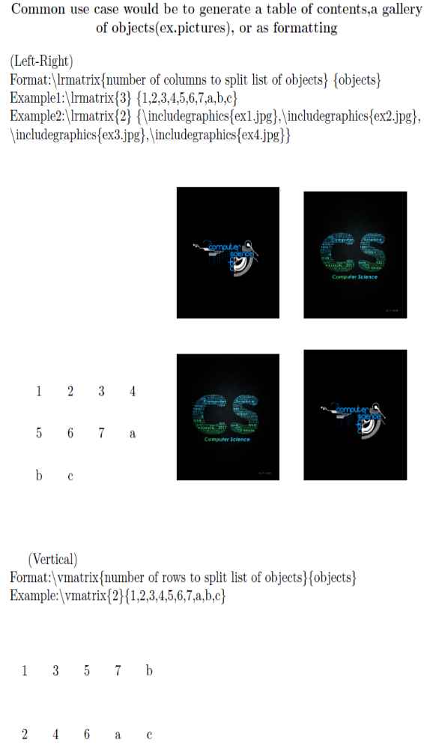

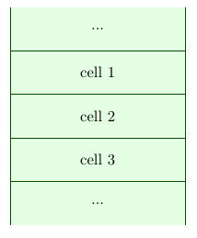
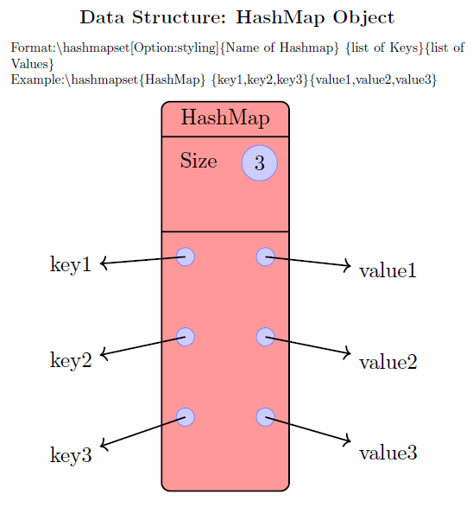
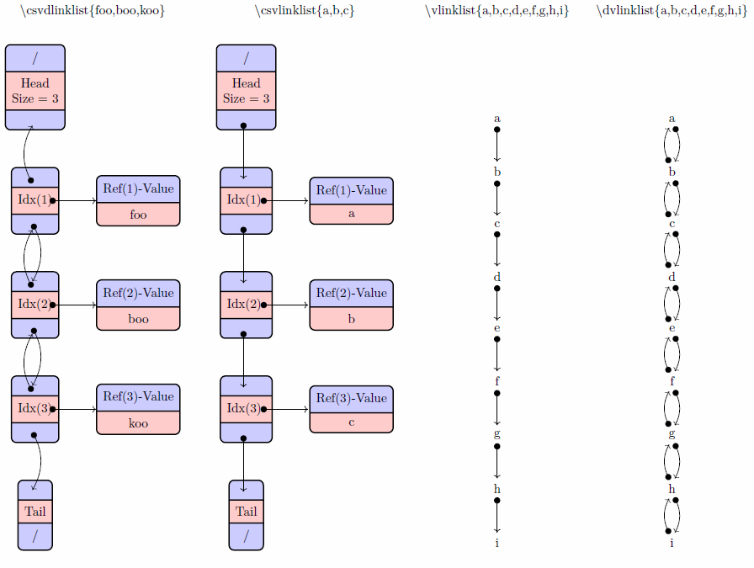

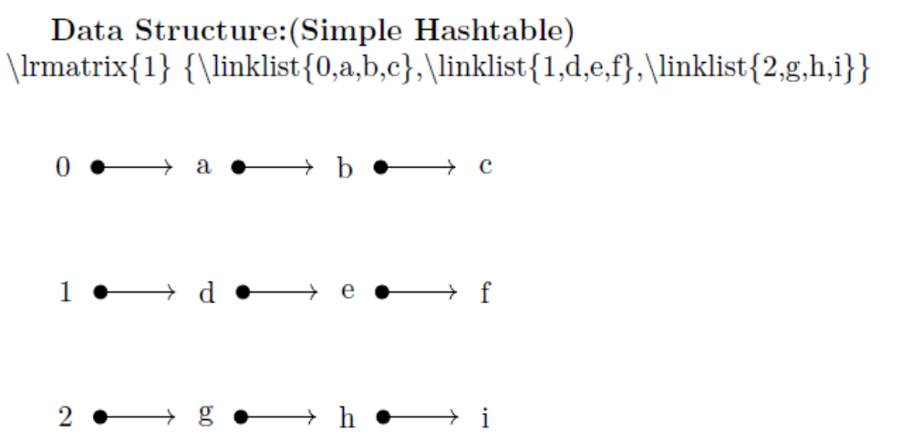
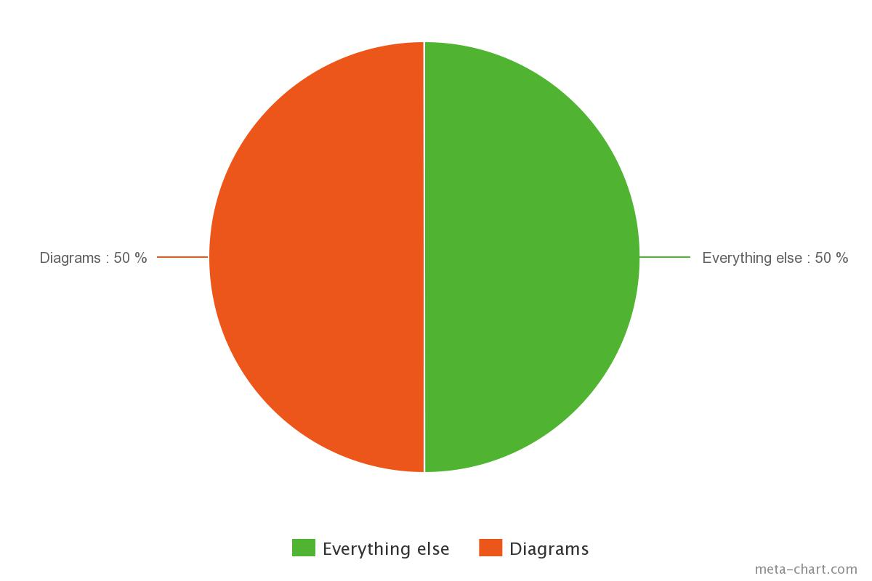

Open Source Text Books
JOVAUGHN A. CHIN, MATTHEW E. DOUGLASS, and EUGENE A. FEDOTOV , Computer Science
Faculty Sponsor: Prof. S. Bergmann¹, Computer Science Dept.
Professional book publishing can cost upwards of thousands for every book. This significantly limits who can buy and publish textbooks simply due to the cost. Open source textbooks (textbooks created by multiple authors, collaborating on the internet) utilizing the high-quality typesetting system known as LaTeX are becoming more common place when it comes to book publishing. A standard in LaTeX open source text-books must be established. One of the main obstacles to the production of open source textbooks lies in the process of generating figures and diagrams. This project attempts to establish a standard in LaTeX book creation and create various common place computer science diagrams as well as some diagrams from other areas of research.
Contribution to the aid of easing the use of producing graphics for the Open Source Community, thus encouraging Open Source Book Production:
Open Source TextBooks should be encouraged to promote Open Source Knowledge, in a sense of sharing knowledge free of price. No more $300+ College textbooks for students.
Collection Package: aid in the visualization of Data Structures and Objects in the Theory of Computer Science, as well as, being flexible enough to accept any object(text,pictures,or any graphics) as input and customize to the user's desire.
Costs of Self-Publishing a Book
Source: http://www.the-efa.org/res/rates.php, 4/22/15 Assume 5 pages/hour. 83,756 words/250 words per ms = 336 pages. Note: 1 manuscript page = 250 words
Editing, developmental | $45/hour*68 hours =$3060
Fact Checking |  | $30/hour * 68 hours=$2040
Total = already at $5,000.
Bergmann, S. "Open Source Textbooks”, Publishing Research Quarterly, Vol 30, Number 1, March 2014.

